Slide 1


PRODUCTION INPUTS AND OUTPUTS
Q4 2018
© 2018 KOKO Networks Limited – Proprietary & Confidential

Slide 2

Welcome

Slide 3
KOKO Networks
KOKO’s Mission is to Improve Life For Everyone in Africa’s Cities
We do this first by mainstreaming a clean fuel solution to replace charcoal and kerosene.
This platform will then be leveraged for advertising, e-commerce, e-health, digital financial services and connectivity solutions

Slide 4
What do we want to be known for?
Pending Review
efficiency and innovation
professionalism (integrity and leadership)
reliability and consistency
delivering value
Transparency
creativity / thinking outside the box
Collaboration
exuberance and energy
meet deadlines
get things done
Quality
Accountability
Trust
Unity
Ambition
Safety
World Class Manufacturing Facility(OEE 90%)
Notes:
efficiency and innovation, professionalism (integrity and leadership), reliability and consistency, delivering value, transparency, creativity / thinking outside the box, collaboration, exuberance and energy, meet deadlines, get things done, quality, accountability, trust, unity, ambition, safety

Slide 5
Q4 Focus | Key Objectives
Build Agent Pipeline and Start KP Deployment
700 Paid Applications by 31st Dec
Contracts signed by 300 High Priority agents with 10k deposit paid by 31st Dec
500 additional locations inspected by 31st December
Modifications and Civil Works productivity at >15 locations / day by 31st December
Launch KOKOpoint Manufacturing
Detailed production plan in place by 31st November
All KP parts & assembly equipment ordered, received and tested by 21st December
>10KP / day manufacturing productivity by 7th Jan
Q4 Milestone in VIVO Implementation Plan
Order placed for 6,000m3 of fuel, with a defined delivery date by 16th Nov
Mombasa fuel storage finalised & civil works committed by 9th Nov
10 SDS installed on converted Shell stations by by 21st December
Communication & risk management strategy in place by 19th Oct
Prepare for Operations beyond Hard Launch
Stove outbound & reverse logistics plan signed off by ExCo by 14th Dec
NOC dashboards and staffing finalised. Draft SLAs created by 31st Dec
All ERP requirements finalised by 26th Oct

Slide 6
Q4 Focus | Key Objectives – Mark
Launch KOKOpoint manufacturing
Detailed production plan in place by 31st November, including staffing, store processes, work in progress, etc.
All KP parts & assembly equipment ordered, received and tested by 31st December.
Production of 210 sub assemblies produced by Dec 31st 2018
>10KP / day manufacturing productivity by 7th Jan
Launch network technology manufacturing
10 SDS installed on converted Shell stations by 31st December
Finalise design aspect of the SDS,set test rigs and test by 31.12.18
Assembly of the SDS unit after arrival of components to be assembled by 31.12.18
Hire and Collaborate better
Operations excellence foundations training by 31st November 2018 existing and new teams to join.
Safety training for the employees on Task hazard assessment,Job safety analysis by 31st November
Organisation hired in line with agreed deadlines as per hiring plan.(see separate hiring plan)

Slide 7
Q4 | Inputs and Outputs
Data & Analysis
Production Productivity O.E.E
Quality Reports (First time right quality).
Floor preparations,team training,QC test rigs readiness as per quality plan
Safety training
Inputs
As per hiring plan and budget the department needs to recruit assembly ,sub assembly technicians and quality supervisor, Stores personnel as well as technicians to achieve my goals.
Engineering Design team to have final BOM (specifications)to ensure supply chain deliver as per schedule for inspection and production of KPs.
Production floor layout marking, quadrant allocation per activity, visual management.
RM receiving ,QC inspection test rigs, stores racks and processes ready , Team hired trained, production of KPs
Production , Material Resource, Quality Planning
KOKOPOINT PRODUCTION
QC PASS
MAIN ASSEMBLY
IN LINE QC CHECKS
SUBASSEMBLY
RM QC CHECK
RM RECIEVING
Outputs
Production of 210 Subassemblies by 31st Dec 2018
10 SDS installed on converted Shell stations by 31st December.
Detailed production plan in place by 31st November, including staffing, store processes, work in progress, etc.
All KP parts & assembly equipment ordered, received and tested by 21st December.
>10KP / day manufacturing productivity by 7th Jan
Support | Resources | Removing Bottlenecks | SLAs | Formal Authority
Notes:
- We need to be more formal as a company

Slide 8
SIPOC
Supplier | Inputs | Process | Outputs | Customer
Saarus India | Kokopoint shell fabrication |  | 10KP / day manufacturing productivity by 7th Jan | Deployment / Agent
 | Information, material stainless steel |  | 10KP / day manufacturing productivity by 7th Jan
Systems Engineering | KoKopoints BOM |  | Quality Kokopoint | Main assembly
 | SDS and STS BOM |  | Quality SDS and STS units | Main assembly/Shell Station
Quality control | QC Control plans |  | Production of 210 Subassemblies by 31st Dec 2018 | Main assembly
 | Qc test checks records |  |  | Main assembly And Sub assembly
 | Goods received note, Goods inspection form |  | Inspection records /Traceability records
Supply Chain | Supplier QC COAs records |  | All KP parts & assembly equipment ordered, received and tested by 21st December. | Production
 | Pre-qualification of suppliers |  | All KP parts & assembly equipment ordered, received and tested by 21st December. | Production
Engineering Support | BOM generation and SpecsDesign and process CTQs |  | Released version of design Product design validation, BOM validation | Production/Procurement
Planning team, Human Resources | Production Plan, Project Plan hire Plan |  | Detailed production plan in place by 31st November, including staffing, store processes, work in progress, etc
KOKOPOINT PRODUCTION
QC PASS
MAIN ASSESMBLY
IN LINE QC CHECKS
SUB ASSEMBLY
RM QC INSPECTION
STORES RECEIVE AND ISSUE PROCESS
RM SOURCING
ENGINEERING DESIGN

Slide 9
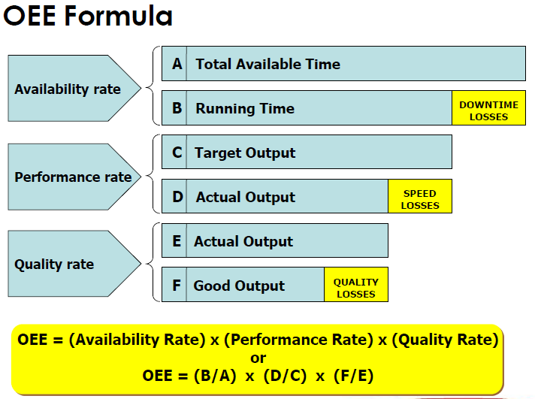
Metrics – Production and Quality metrics
Overall Equipment Effectiveness (OEE) Availability x Performance X Quality) : Is a measure to evaluate the productivity of a piece of equipment or a production line
OEE Analysis :− is a method used to analyze equipment performance, accounting for losses due to availability, performance, and quality

Slide 10
Next Steps From This Session
ACTIONS | DUE DATE | OWNER
Finalise individual & team OKRs | Fri, 12 October | Completed
Finalise Process Inputs and Outputs | Mon, 15 October | Completed
Raise any challenge with deadlines or resourcing | Wed, 17 October | List Provided
Finalise project plans | Wed, 17 October | All Ops
Finalise review cycles and project management | Wed, 24 October | Stephan
Authority Matrix for OPS | TBC | Stephan / Exco
Feedback to SG on best way to manage / communicate as a team | Fri, 19 October | All Ops Mng
OPS Leadership Team Drive | Fri, 12 October | Morris
Update 12-month budget forecasts | Fri, 19 October | Stephan

